Slide 1


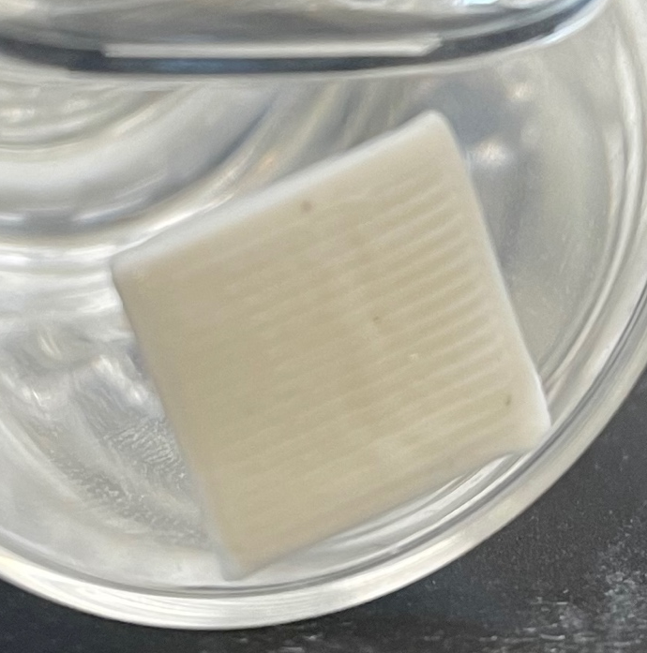
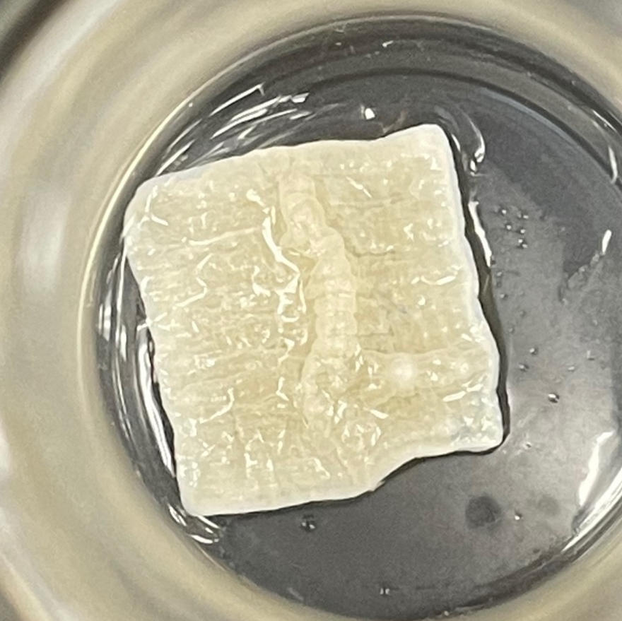
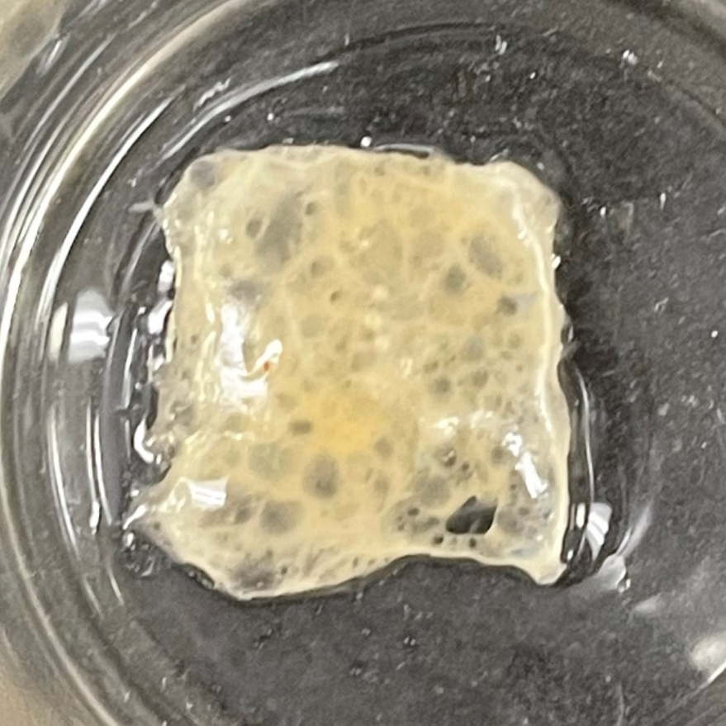
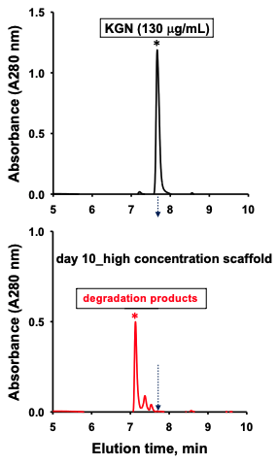
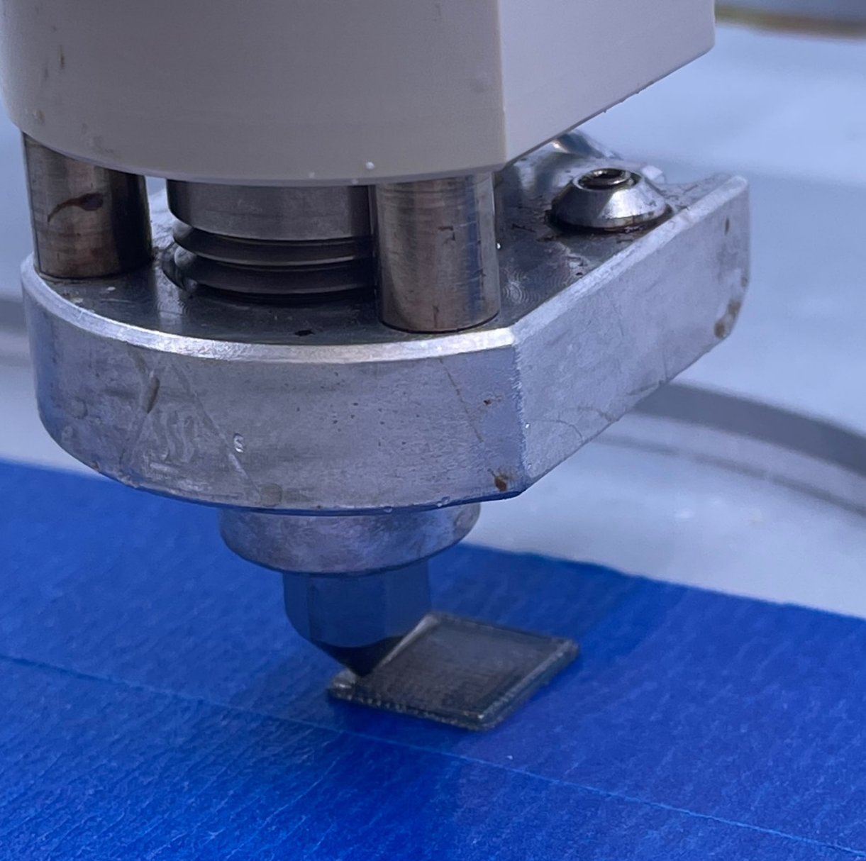
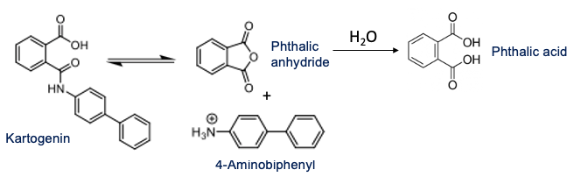
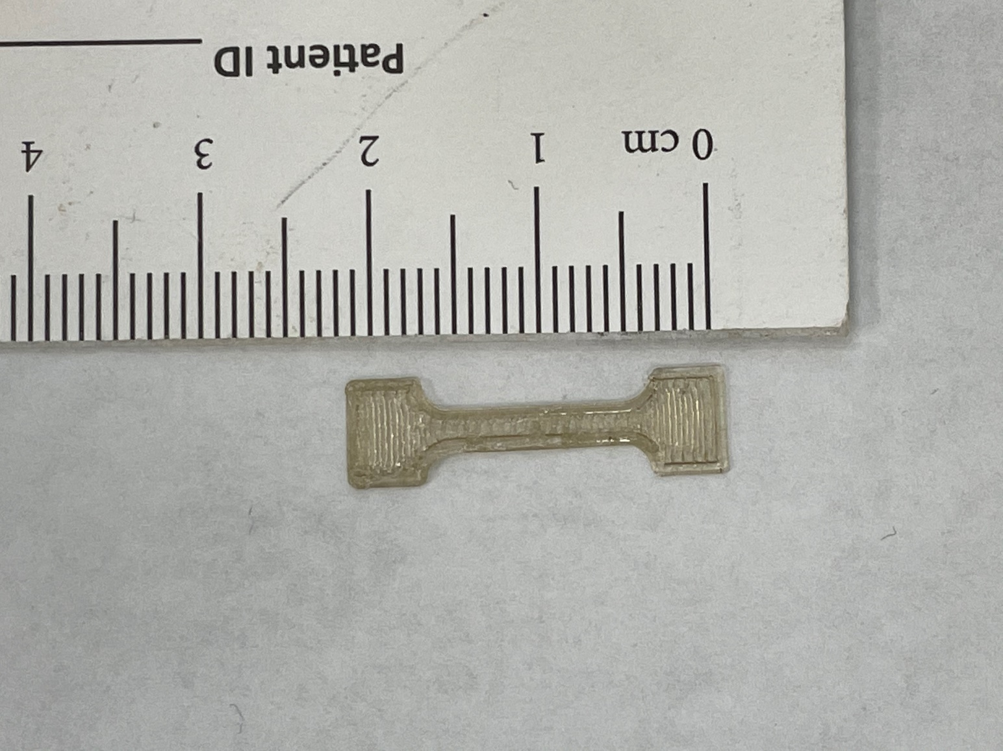
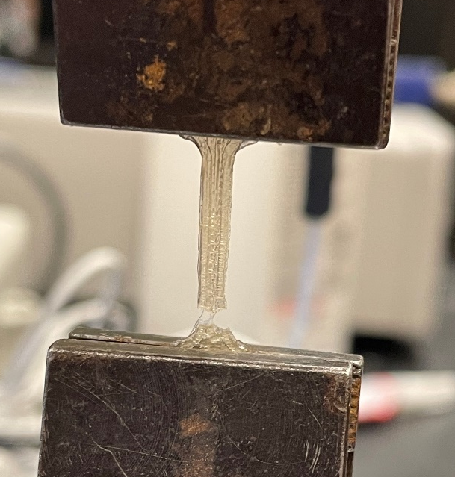
Bioprinting and evaluation of PLGA-KGN scaffolds as an augmentation to microfracture James D. Warren¹, Daniel Young², Matthew Ross², Steve Elder¹ ¹Department of Agricultural and Biological Engineering; ²Department of Basic Sciences, College of Veterinary Medicine
BACKGROUND
RESULTS
CONCLUSIONS
KGN
Cartilage is avascular and has almost no intrinsic healing capacity. Microfracture (MFx) is a common procedure involving puncture of subchondral bone so that marrow mesenchymal stem cells (MSCs) can access the defect. MFx is indicated only for lesions <2 cm² because it results in fibrocartilage that is mechanically inferior to normal, hyaline cartilage. The proposed augmentation to MFx would overcome its limitations by introducing a bio-printed PLGA scaffold containting kartogenin (KGN), a small bioactive compound that promotes differentiation to the hyaline cartilage phenotype.¹ The aim of this study is to fabricate a PLGA-KGN scaffold and determine its degradation properties and mechanical characteristics.
Scaffold Degradation
KGN does not interfere with ability to print PLGA scaffolds
KGN can be efficiently loaded into PLGA scaffold and survive printing process.
Release of KGN and/or its degradation products occurs in tandem with PLGA hydrolysis.
KGN does not negatively impact PLGA mechanical properties.
Overall, this method of scaffold fabrication and functionalization is a very viable option for delivering KGN to cartilage defect sites immediately after microfracture.
Scaffolds gradually broke down through a process of bulk erosion (Fig 4).
a
b
c
METHODS
Figure 4. Scaffolds at 5 days (a), 15 days (b), and 25 days (c).
PLGA-KGN Scaffold Fabrication
PLGA (50:50 PGA:PLA) and KGN were dissolved in dichloromethane to create a 20% PLGA wt/vol solution containing 5.827 ug KGN per 100 mg PLGA.
Solvent was evaporated off and resulting PLGA-KGN mixture was ground to a powder for use in bioprinting.
PLGA-KGN scaffolds of 10 x 10 x 1 mm were printed on Cellink Bio X (Fig. 1) using parameters below. Efficient loading of KGN was confirmed by dissolving the scaffold and detecting KGN using UV-Vis spectrophotometry at 284 nm.
Measuring KGN Release
Two PLGA-KGN scaffolds were printed and soaked in 15 mL sterile PBS at 37ºC under gentle agitation to investigate sustained release of KGN.
Supernatant collected and PBS replaced every five days for 30 days.
KGN released into supernatant was detected using HPLC.
Mechanical Evaluation
Tensile specimens (Fig. 2) were printed from PLGA (n=5) PLGA-KGN (n=8).
All samples were stretched on a stepper motor-driven micromechanical testing machine at a constant rate of 0.05 mm/s until specimen rupture (Fig. 3).
KGN Release
KGN detected from biphenyl signature displayed on HPLC-UV trace by KGN and its degradation products (Fig. 5a)
KGN degradation products were observed in soaking solution from each time interval (Fig 5b), indicating sustained release of KGN from PLGA scaffold over 25 days.
FUTURE WORK
Biphenyl signature
KGN
Further work will aim to confirm the chondrogenic activity of released kartogenin in vitro using primary marrow-derived mesenchymal stem cells.
Chondrogenic influence of the proposed augmentation will also be evaluated in vivo using a rat knee model of knee microfracture.
PLGA-KGN Bioprinting Parameters
Temperature | 150 C
Pressure | 400 kPa
Print Speed | 2 mm/s
Nozzle Diameter | 0.3 mm
Pre-flow | 200 ms
Post-flow | 0 ms
a
Peak is probably 4-aminobiphenyl
Figure 1. PLGA scaffold being printed
c
b
Figure 5. (a) Absorbance peaks of KGN and degradation products both align with biphenyl signature.(b) HPLC-UV chromatogram showing presence of KGN degradation products at day 10. (c) Proposed degradation scheme of KGN in solution.
REFERENCES
KGN
Mechanical Evaluation
Johnson, K. et al. A stem cell-based approach to cartilage repair. Science (80-. ). (2012). doi:10.1126/science.1215157
Zhang, S. et al. Kartogenin hydrolysis product 4-aminobiphenyl distributes to cartilage and mediates cartilage regeneration. Theranostics 9, 7108–7121 (2019).
Mechanical testing results are summarized in Figure 6.
Elastic modulus and tensile strength of PLGA remained unaltered by the addition of KGN (p>0.05)
Addition of KGN significantly increased toughness of PLGA (p<0.05)
*
ACKNOWLEDGEMENTS
KGN
This research was funded by the generous contributions of the Judy and Bobby Shackouls Honors College at Mississippi State University.
Figure 2. Bio-printed PLGA-KGN? tensile specimen
Figure 3. Tensile failure of PLGA-KGN scaffold
Figure 6. Mechanical characteristics of PLGA-KGN and control PLGA. *p-value <0.05
Notes:
Hello, my name is Jay Warren and I am a senior biomedical engineering major here at Mississippi State. My research is focused on a tissue engineering approach to microfracture, a procedure commonly performed to treat and restore damaged cartilage in patients with osteoarthritis.
(slight pause)
BACKGROUND
Articular cartilage is avascular, so it is unable to heal itself when damaged. Microfracture drills small holes in the subchondral bone, recruiting blood to the surface of the cartilage defect. This blood contains mesenchymal stem cells that can potentially differentiate into chondrocytes.
The main limitation of microfracture is that the regenerated tissue is composed of fibrocartilage, which is mechanically inferior to normal hyaline cartilage and has limited durability.
The proposed augmentation to microfracture would introduce a bio-printed PLGA scaffold that is functionalized with kartogenin, a small bioactive compound that aids in chondrocytic differentiation of mesenchymal stem cells. This scaffold would be attached to the defect site immediately following microfracture procedure. As the PLGA scaffold naturally degrades in the body, the kartogenin that is released will direct the differentiation of the recruited mesenchymal stem cells into the preferred hyaline cartilage.
The aims of this study were to fabricate a PLGA-KGN scaffold and determine its degradation properties and mechanical characteristics.
(pause for next section)
METHODS
To fabricate the scaffolds, dissolved PLGA and kartogenin were combined at a ratio of 7.575 ug kartogenin to 130 mg PLGA. This ratio reflects our calculations for delivering a therapeutic dose of kartogenin to the defect site from the implanted scaffold. This mixture was left overnight in the fume hood to evaporate the organic solvent. The dried mixture was then ground to a fine powder for use in bio-printing. Scaffolds of 10 x 10 x 1 mm were then printed on the bioprinter with the print parameters shown in this table. Kartogenin loading was evaluated at this point by completely dissolving the scaffold in DMSO and using spectrophotometry at 280 nm to confirm a high level of loading efficiency. At this point, we knew that kartogenin could survive the printing process and could be loaded into the scaffold.
To evaluate kartogenin release, we released two of the scaffolds into 15 mL PBS at 37 ºC under gentle agitation. The supernatant was collected and replaced every 5 days for 25 days. We determined kartogenin release for each time interval using high performance liquid chromatography.
To evaluate mechanical properties, we conducted tensile testing on specimens made from the PLGA-KGN mixture as well as pure PLGA. The specimens were stretched at a 0.05 mm/s displacement rate until rupture, and the resulting force vs displacement data was used to calculate elastic modulus, tensile strength, and material toughness for each sample.
(slight pause for next section)
RESULTS
After measuring kartogenin release over the 25-day period, we noticed that kartogenin actually degraded according to the schematic shown in Figure 1a. Initially, we had planned to construct a release curve using concentration of kartogenin as a dependent variable, but we were unable to do so since kartogenin degraded over time in solution. We were, however, able to obtain spectra that indicate the presence of KGN degradation products in each time interval. Shown in Figure 1b is the the presence of degradation products at the 10-day reading. Similar peaks were observed in every other time interval. The main absorbance peak shown in Figure 1c is a biphenyl signature. Both KGN and the degradation products that were present at each interval feature this signature.
So, the fact that KGN degradation products were observed at each time interval over 25 days confirms that the KGN does undergo a sustained release from the scaffold. Other studies have determined that the 4-aminobiphenyl degradation product of KGN is the compound responsible for chondro-induction, so the breakdown of KGN in solution by no means impacts the scaffold’s chondro-inductive capacity, it just somewhat prevented us from quantifying KGN’s exact release profile.
(pause for pan)
Scaffold degradation was visibly observed throughout the process, as shown in Figure 2.
The results of the tensile testing indicate that the addition of KGN does not seem to significantly impact PLGA’s elastic modulus or its tensile strength. KGN does however seem to significantly increase the overall toughness of PLGA.
(pause for next section)
CONCLUSIONS
Our findings indicate a few things. Firstly, our preliminary analysis of KGN loading efficiency confirms KGN’s ability to be loaded into the scaffold and its ability to withstand the high temperatures and pressures associated with the bio-printing process.
Secondly, the sustained release of KGN from the scaffold appears to occur in tandem with PLGA degradation. That being said, there are many modifications that can be made to PLGA’s chemical properties that would influence its overall degradation properties, like changes to molecular weight, PGA:PLA ratio, and etcetera. The scaffold’s geometry and porosity can also be modified to change its degradation profile. This means that in theory, KGN release from the scaffold can be tailored to the needs of the patient.
The results also indicate that the inclusion of KGN is not detrimental to PLGA’s mechanical properties. In fact, the increased fracture toughness of functionalized PLGA further increases the scaffold’s ability to withstand joint loading.
Overall, these findings suggest that this method of scaffold fabrication and functionalization is a very viable option for delivering KGN to defect sites immediately after microfracture.
Further work on this project will aim to confirm the chondrogenic activity of released kartogenin in vitro using primary marrow-derived mesenchymal stem cells. These cells have been acquired and are currently being expanded. Chondrogenic influence of the proposed augmentation will also be evaluated in vivo using a rat model of knee microfracture.
This augmentation to microfracture has the potential to overcome the limitations of the procedure and promote the regeneration of healthy, functional cartilage in patients with osteoarthritis.
Thank you.

